Slide 1
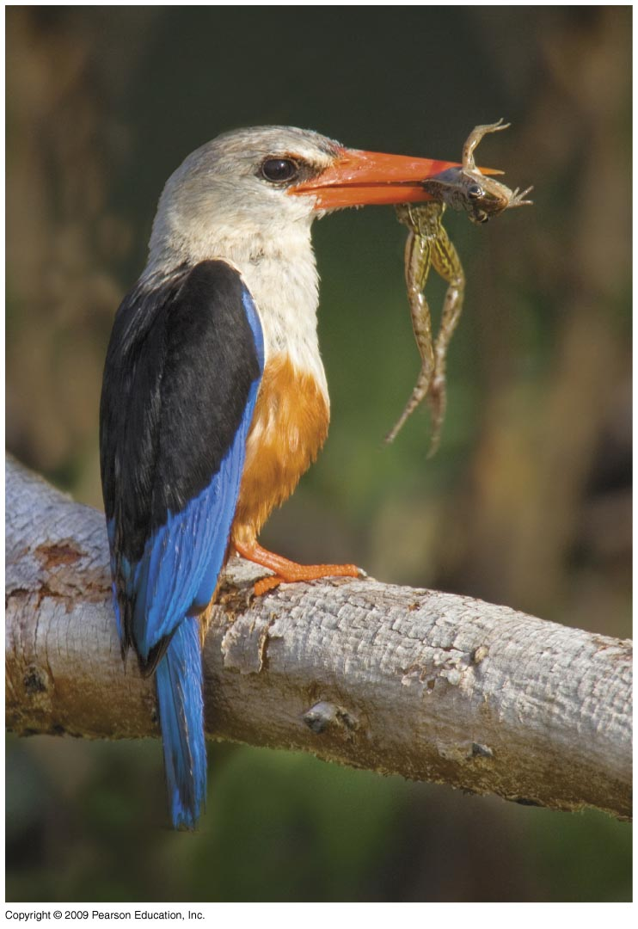
Limits to Distributions: Biotic factors
See chapter 6 of Krebs (2014)

Slide 2
Limits to Distributions: Biotic Factors
Part i
Dispersal – definitions, examples, mechanisms
Part ii
Establishment / colonization
(Continental drift / Ice Ages)
Habitat preferences
Part iii
Effects of predators, prey, parasites, pathogens

Slide 3
Dispersal
Lack of detailed knowledge of distributions
dispersals for most species go unnoticed
Dispersal to new area may occur but with failure to colonize (establish)

Slide 4
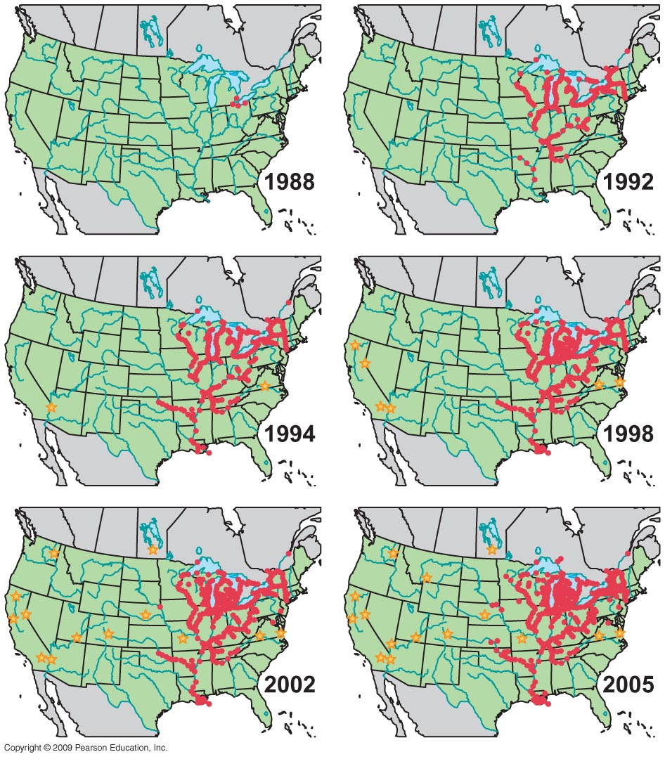
Non-native species can spread very quickly if conditions are suitable
Yellow stars = discovery points of overland movement (on boats pulled in trailers)
Dreissena polymorpha Zebra mussel expansion
Source: US Geological Survey, 2007

Slide 5
Non-native species can spread very quickly if conditions are suitable
Source: US Geological Survey, 2007

Slide 6
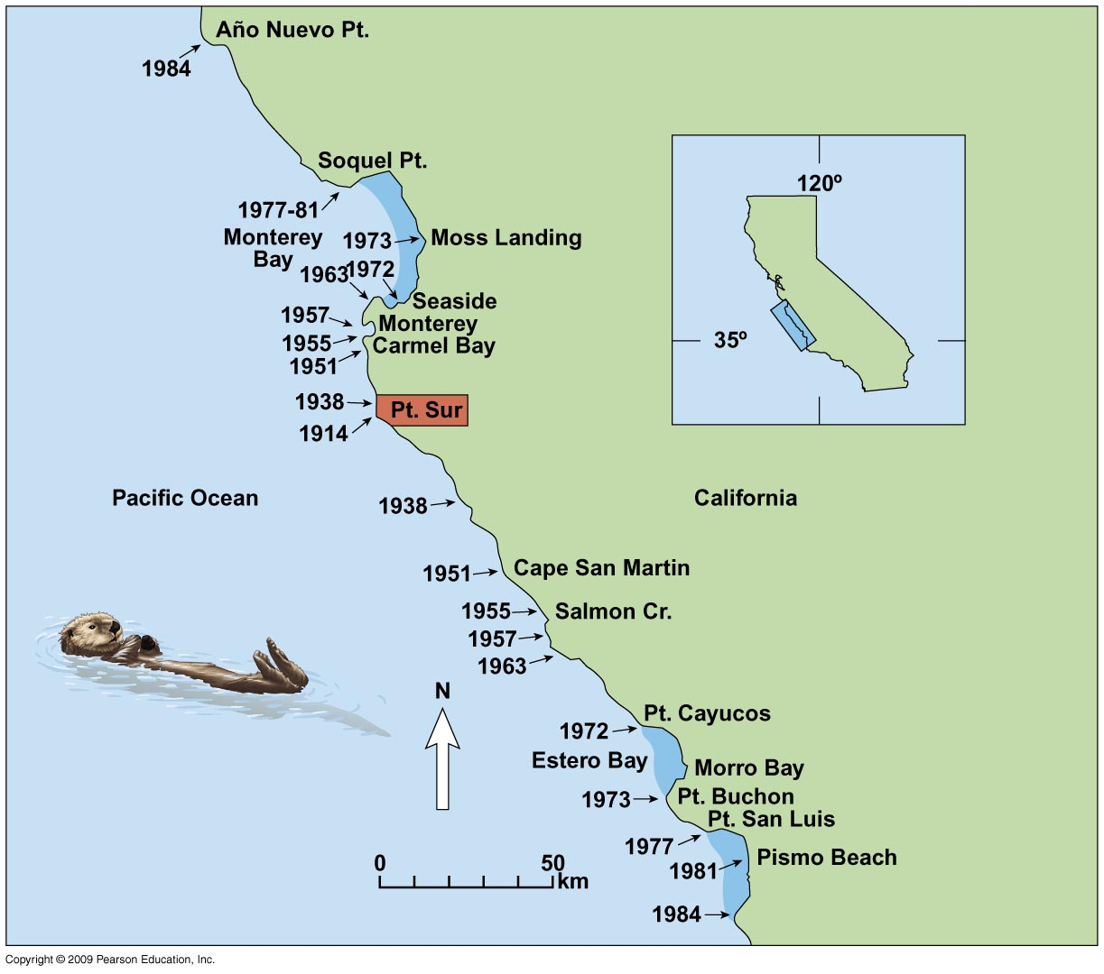
Native species can re-colonize quickly if conditions improve
Enhydra lutris California sea otter
Lubina & Levin (1988) American Naturalist 131: 526-543

Slide 7
What do we mean by dispersal?
Diffusion
Gradual movement across hospitable terrain over several generations
e.g. sea otter
Jump dispersal
Fast movement over large distance followed by successful establishment in new area
e.g. zebra mussel
Secular dispersal
If diffusion occurs VERY slowly (geologic time) – spreading species undergoes evolutionary change

Slide 8
Observed dispersal can be faster than expected
Britain after Ice Age
From 8,000 BC to 50 AD oaks expanded their range ~1,000 km
Yet predictions modelled on reproductive rate and average dispersal distance suggest expansion should only have been 36 km
Based on 10⁷ seeds per generation for 300 generations & seed dispersal of 30 m per generation
Reid’s paradox

Slide 9
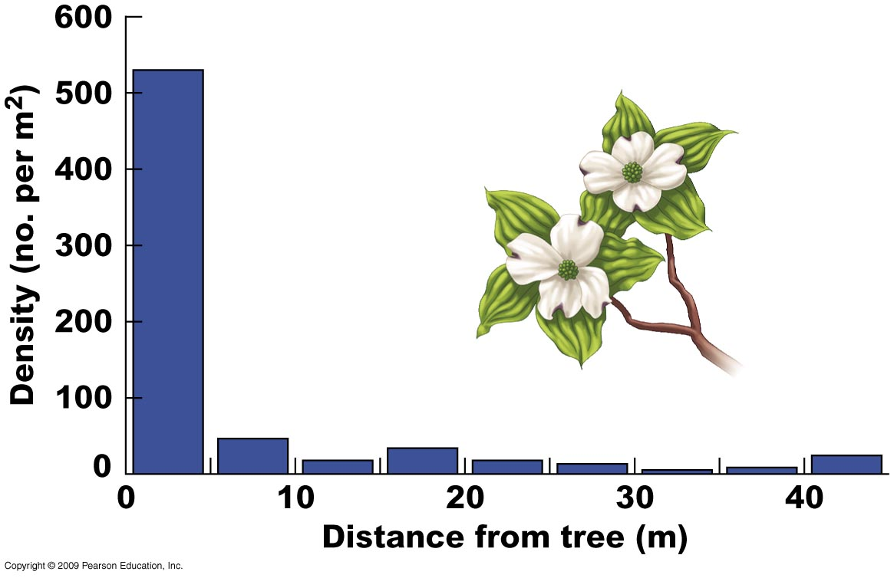
Seed dispersal distance
Cornus controversa Dogwood
Masaki et al. (1994) Ecology 75: 1903-1910

Slide 10
Observed dispersal can be faster than expected
Britain after Ice Age
Oaks expanded their range ~1,000 km
Yet predictions modelled expansion as 36 km
Reid’s paradox
Explanation?
Colonization driven not by mean dispersal distance but by extreme dispersal event
Clark et al. (2001) American Naturalist 157: 537-554.

Slide 11
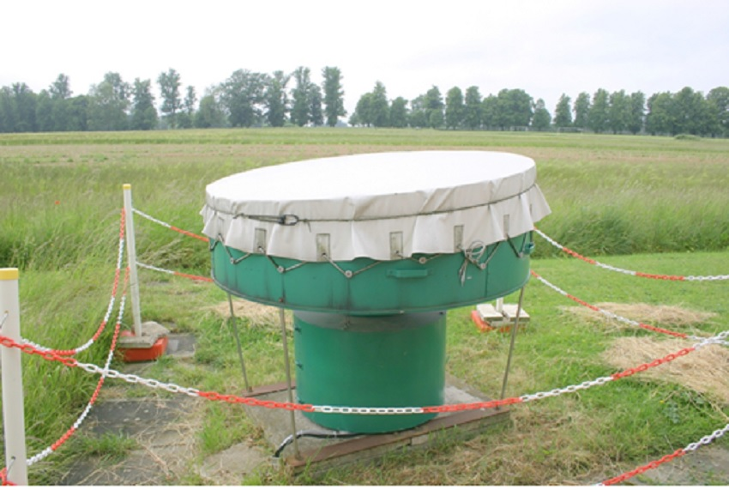
Observed dispersal can be faster than expected
Continental scale dispersal aided by humans
But many species are highly dispersive
especially plants (seeds & spores) & invertebrates (travelling on wind)
e.g. Ladybirds
detected up to 1100 m above ground level
potentially able to travel up to 120 km at high altitudes
Vertical-Looking Radar
www.rothamsted.ac.uk
Jeffries et al. (2013) PloS One 8(12): e82278
Notes:
Understanding the characteristics and drivers of dispersal is crucial for predicting population dynamics, particularly in range-shifting species. Studying long-distance dispersal in insects is challenging, but recent advances in entomological radar offer unique insights. We analysed 10 years of radar data collected at Rothamsted Research, U.K., to investigate characteristics (altitude, speed, seasonal and annual trends) and drivers (aphid abundance, air temperature, wind speed and rainfall) of high-altitude flight of the two most abundant U.K. ladybird species (native Coccinella septempunctata and invasive Harmonia axyridis). These species cannot be distinguished in the radar data since their reflectivity signals overlap, and they were therefore analysed together. However, their signals do not overlap with other, abundant insects so we are confident they constitute the overwhelming majority of the analysed data. The target species were detected up to ~1100 m above ground level, where displacement speeds of up to ~60 km/h were recorded, however most ladybirds were found between ~150 and 500 m, and had a mean displacement of 30 km/h. Average flight time was estimated, using tethered flight experiments, to be 36.5 minutes, but flights of up to two hours were observed. Ladybirds are therefore potentially able to travel 18 km in a “typical” high-altitude flight, but up to 120 km if flying at higher altitudes, indicating a high capacity for long-distance dispersal.

Slide 12
Limits to Distributions: Biotic Factors
Part i
Dispersal – definitions, examples, mechanisms
Part ii
Establishment / colonization
(Continental drift / Ice Ages)
Habitat preferences
Part iii
Effects of predators, prey, parasites, pathogens

Slide 13
Dispersal is only part of the story
Barriers (e.g. geographic) may halt dispersal
mountains, saltwater, freshwater, linear features (roads & rivers for some invertebrates)
Dispersal ability may not be the limiting factor
Introduced species may not survive
Dispersal
Survival
Establishment

Slide 14
Establishment of introduced birds (terrestrial & freshwater)
Source: Case, 1996
Case (1996) Biological Conservation 78: 69-96.

Slide 15
Establishment of introduced birds (terrestrial & freshwater)
Source: Case, 1996
Higher success rate on islands

Slide 16
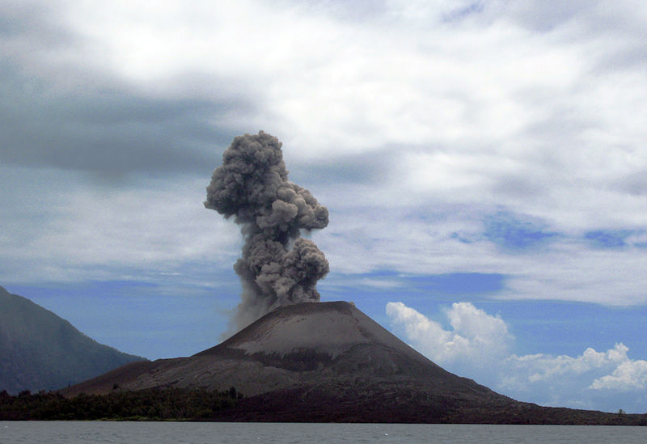
Colonization can be very fast
1883 – Krakatau eruption
two small islands close by sterilized by ash
After 9 months: one spider species
3 yrs: algae, 11 ferns, 15 flowering plants
10 yrs: coconut trees
25 yrs: forest & 263 animal species
Whittaker et al. (1989) Ecological Monographs 59: 59-123

Slide 17
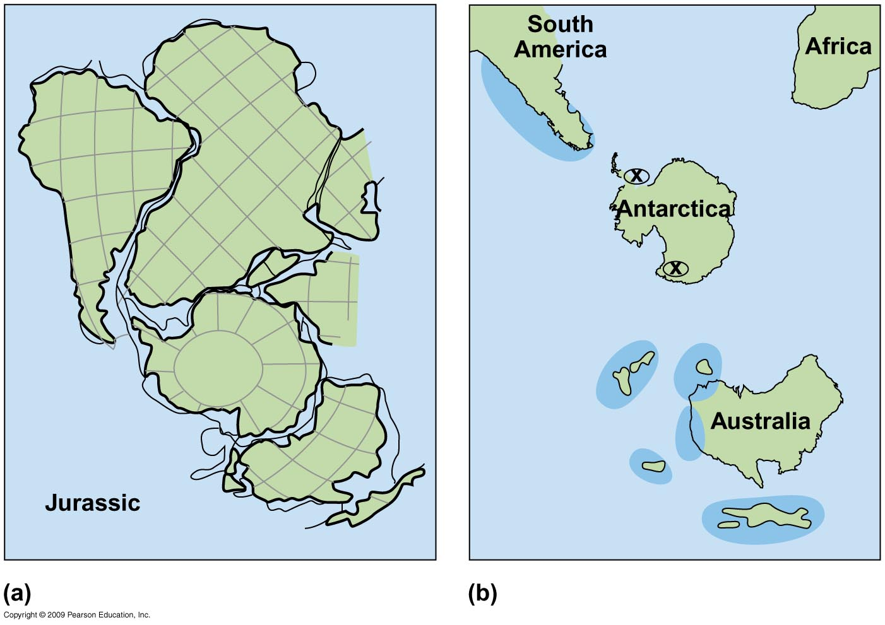
Continental drift explains some distributions
Fit of the Gondwana continents 135 mya, before break-up
Modern distribution of Nothofagus Antarctic beech (darker blue)

Slide 18
Continental drift explains some distributions
Nothofagus illustrates how some present geographic distributions have been set by geologic events
Seeds heavy & poorly adapted for jump dispersal
Dispersal by slow diffusion overland, stopped at coasts
So distribution is a by-product of continental drift
Modern distribution of Nothofagus Antarctic beech (darker blue)

Slide 19
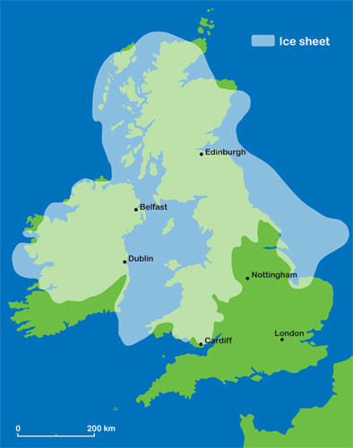
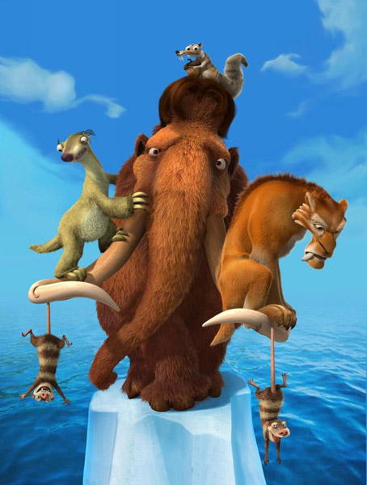
Ice Ages explain other distributions
British ice coverage during the most recent glaciation – the 'Devensian‘
Source: British Geological Survey, www.bgs.ac.uk
Notes:
Map: http://www.bgs.ac.uk/discoveringGeology/geologyOfBritain/iceAge/home.html

Slide 20
Habitat preference
Habitat
Any part of biosphere where a particular species can live (permanently or temporarily)
Animals can ‘choose’ whether to disperse into a new habitat
Plants rely on passive dispersal
Nat. selection favours development of sensory systems for recognizing suitable habitats

Slide 21
Limits to Distributions: Biotic Factors
Part i
Dispersal – definitions, examples, mechanisms
Part ii
Establishment / colonization
(Continental drift / Ice Ages)
Habitat preferences
Part iii
Effects of predators, prey, parasites, pathogens

Slide 22
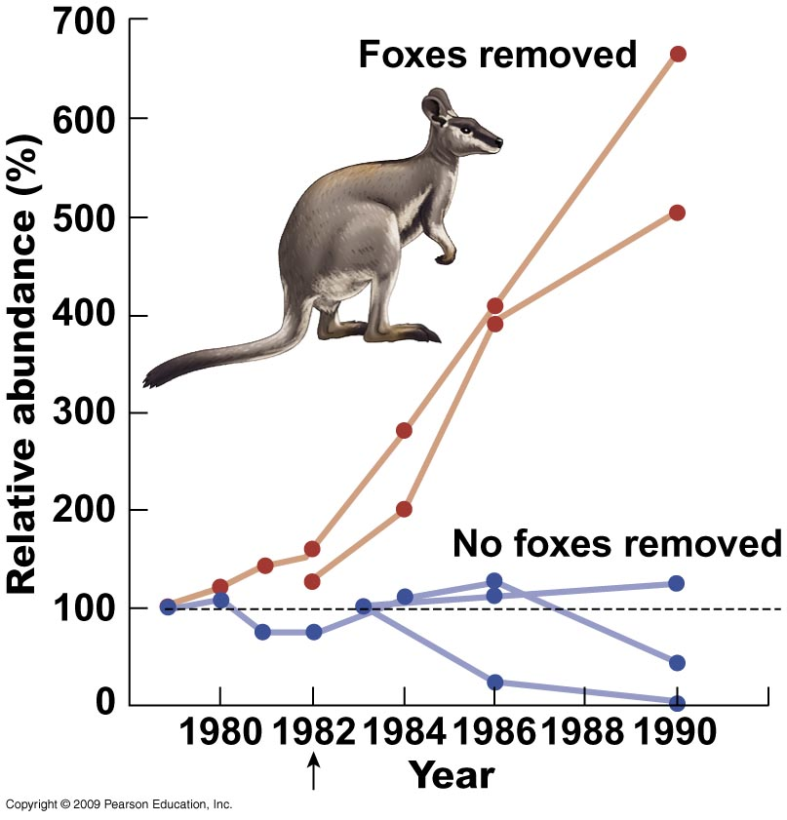
Predators can limit prey distribution
Petrogale lateralis
Rock wallaby
Rock wallaby driven to near extinction by predation from introduced red fox
When foxes poisoned, wallaby numbers increased dramatically

Slide 23
Predators can limit prey distribution
Petrogale lateralis
Rock wallaby
Fox control began
Changes in wallaby abundance at two sites with red fox control & three without
Kinnear et al. (1998) Wildlife Research 25: 81-88. See also Kinnear et al. (2010) Wildlife Research 37: 57-67

Slide 24
Can prey limit predator distribution?
If prey is to restrict predator’s range...
predator must be specialised
limited to 1 or 2 prey species only (i.e. monophagous)
e.g. many insects, but few vertebrate predators

Slide 25
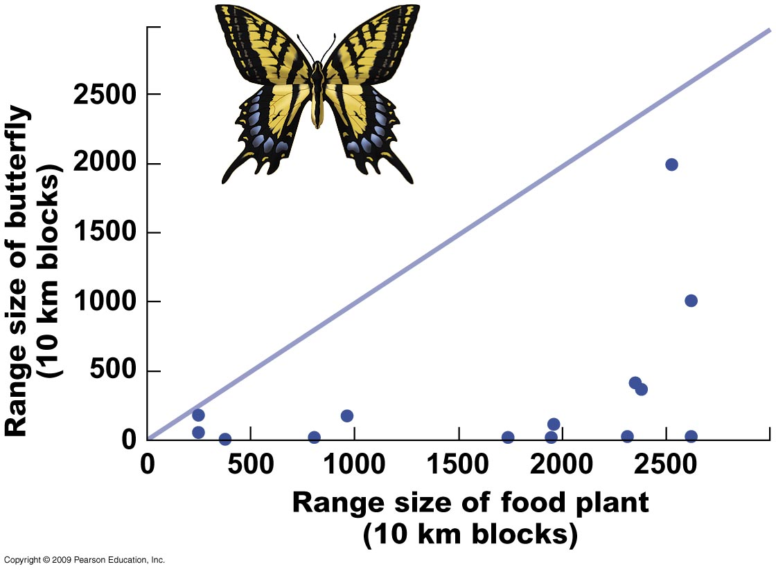
Does host plant range limit herbivore distribution?
No – based on British butterflies
Quinn et al. (1998) Ecography 21: 279-288

Slide 26
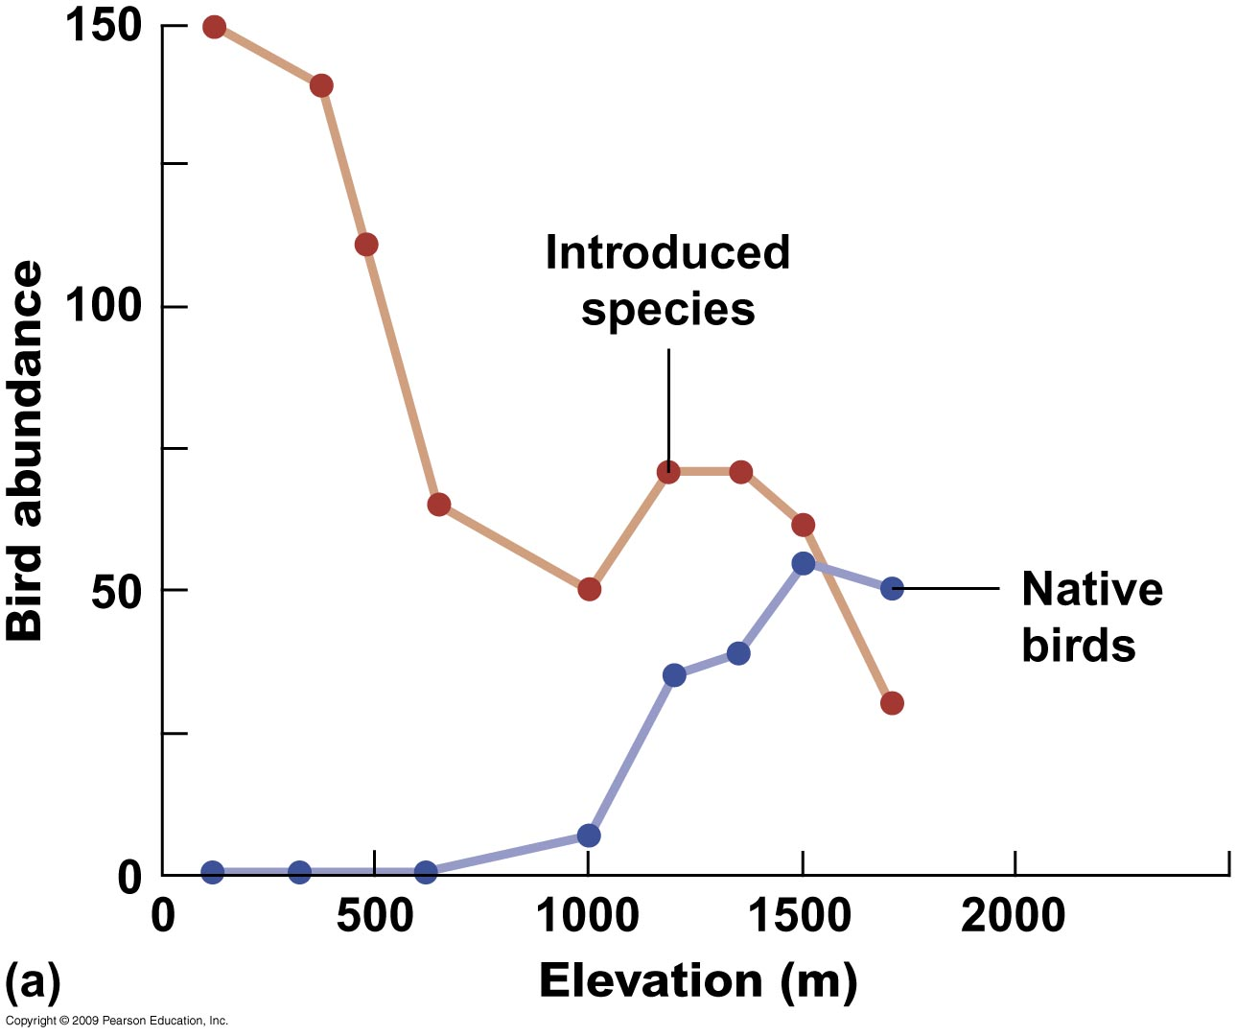
Effect of parasitism on native birds in Hawaii
Native birds only common at high altitudes – while introduced birds occupy lowlands

Slide 27
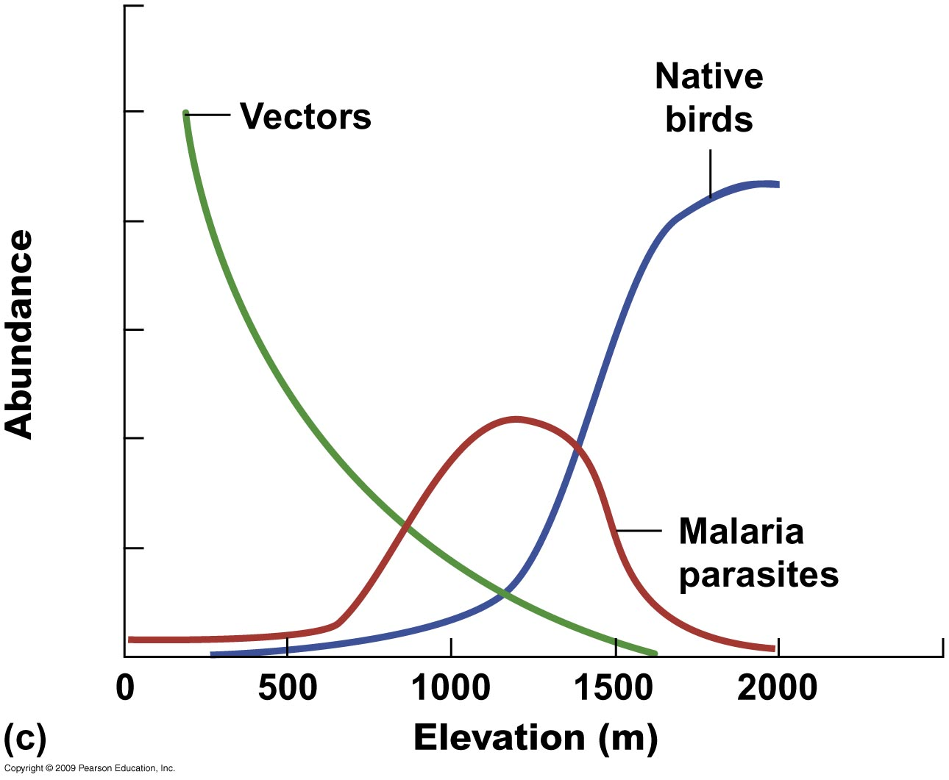
Effect of parasitism on native birds in Hawaii
(mosquitoes)
Parasite peak at elevations where mosquitoes & birds overlap the most
Van Riper et al. (1986) Ecological Monographs 56: 327-344.
See also Freed et al. (2005) The Condor 107: 753-764.

Slide 28
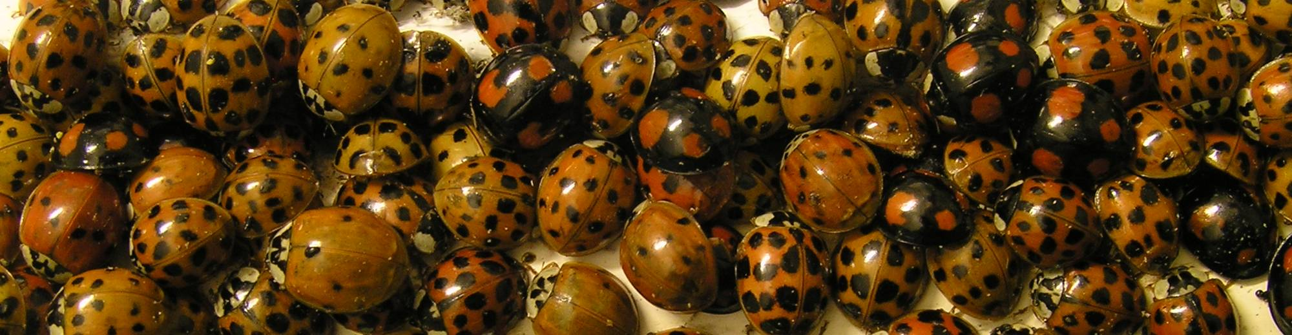
Natural Enemy Escape hypothesis
Successful invasion by harlequin ladybird Harmonia axyridis
due to escape from parasites & pathogens?
© Nick Greatorex-Davies
Roy et al. (2011) BioControl 56: 451-468

Slide 29
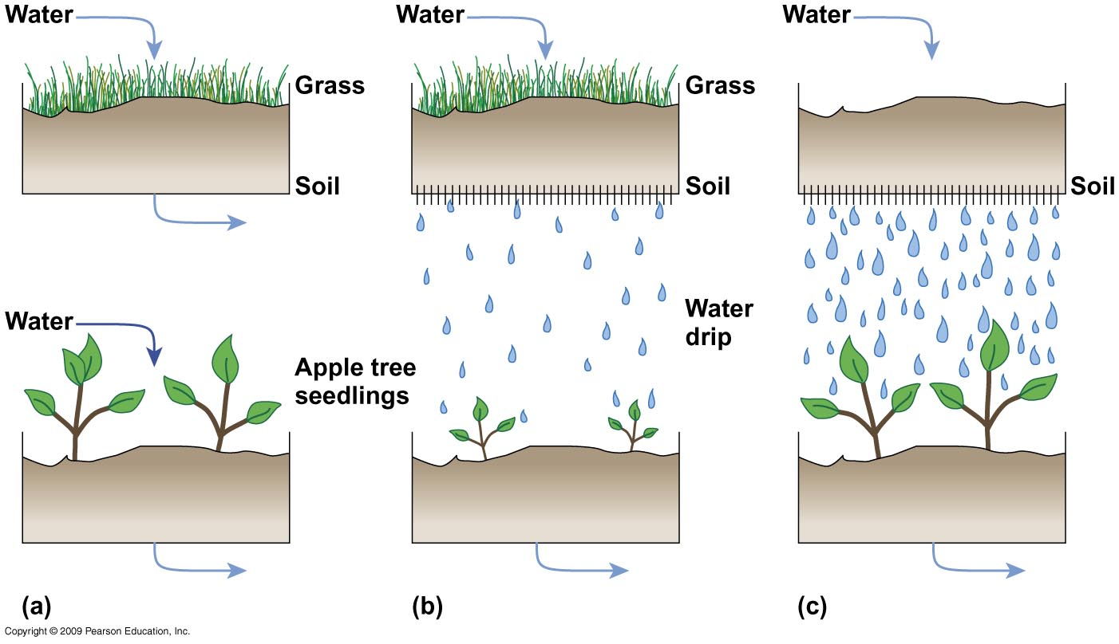
Allelopathy: chemical environment altered by one organism to the detriment of another
Experiments showing detrimental effects of grass on apple tree seedlings

Slide 30
Limits to Distributions: Biotic Factors
Part i
Dispersal – definitions, examples, mechanisms
Part ii
Establishment / colonization
(Continental drift / Ice Ages)
Habitat preferences
Part iii
Effects of predators, prey, parasites, pathogens

Slide 31
References (those in bold especially recommended)
Case, T.J. (1996). Global patterns in the establishment and distribution of exotic birds. Biological Conservation 78: 69-96.
Clark, J.S. et al. (1998). Reid's paradox of rapid plant migration - Dispersal theory and interpretation of paleoecological records. Bioscience 48: 13-24.
Clark, J.S. et al. (2001). Invasion by extremes: Population spread with variation in dispersal and reproduction. American Naturalist 157: 537-554.
Clark, R.G. & Shutler, D. (1999). Avian habitat selection: pattern from process in nest-site use by ducks? Ecology 80: 272-287.
Freed, L. A., et al. (2005). Increase in avian malaria at upper elevation in Hawai'i. The Condor 107: 753-764.
Jeffries, D. L. et al. (2013). Characteristics and drivers of high-altitude ladybird flight: insights from vertical-looking entomological radar. PloS one 8(12): e82278.
Kinnear, J.E. et al. (1998). Fox control and rock-wallaby population dynamics — II. An update. Wildlife Research 25: 81-88.
Kinnear, J. E. et al. (2010). Predator-baiting experiments for the conservation of rock-wallabies in Western Australia: a 25-year review with recent advances. Wildlife Research 37: 57-67.
Krebs, C. (2014). Ecology: the experimental analysis of distribution and abundance. Chapter 5. London: Benjamin Cummings.
Lubina, J.A. & Levin, S.A. (1988). The Spread of a Reinvading Species - Range Expansion in the California Sea Otter. American Naturalist 131: 526-543.
Masaki, T. et al. (1994). Spatial and seasonal patterns of seed dissemination of Cornus controversa in a temperate forest. Ecology 75: 1903-1910.
Quinn, R.M. et al. (1998). Coincidence in the distributions of butterflies and their foodplants. Ecography. 21: 279-288.
Roy, H.E. et al. (2011). Can the enemy release hypothesis explain the success of invasive alien predators and parasitoids? Biocontrol 56: 451-468.
Sexton, J.P. et al. (2009). Evolution and Ecology of Species Range Limits. Annual Review of Ecology Evolution and Systematics 40: 415-436.
van Riper, C. et al. (1986). The Epizootiology and Ecological Significance of Malaria in Hawaiian Land Birds. Ecological Monographs 56: 327-344.
Whittaker, R.J., et al. (1989). Plant Recolonization and Vegetation Succession on the Krakatau Islands, Indonesia. Ecological Monographs 59: 59-123.
Wu, H., et al. (2000). Laboratory screening for allelopathic potential of wheat (Triticum aestivum) accessions against annual ryegrass (Lolium rigidum). Crop and Pasture Science 51: 259-266.

